Slide 1

Enterprise Function
Robert Fogel
Key Objectives, Metrics and Milestones

Slide 2

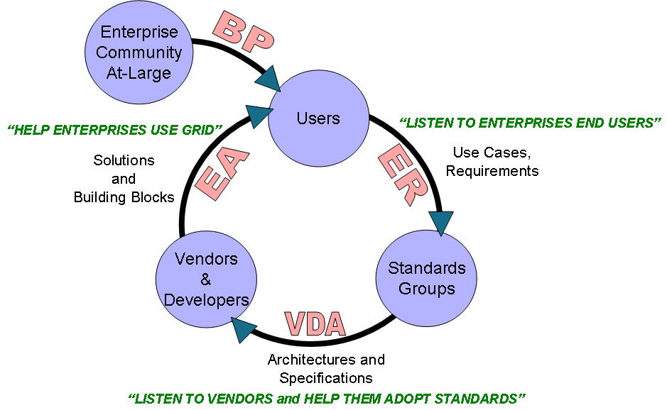
Enterprise Mission
Build an international community to accelerate the adoption of Grid within the enterprise

Slide 3
Enterprise Focus Areas
Enterprise Adoption (Cheryl Doninger)
  Help Enterprises adopt currently available Grid technology
  Enterprise awareness, education and outreach
Best Practices (Nick Werstiuk)
  Capture existing best practices to help end-users today apply currently available Grid technology
Enterprise Requirements (Robert Cohen and Ravi Subramaniam)
  Influence OGF standards to comprehend the needs of enterprise & eScience end uses
  Work with the OGF standards to focus on requirements that are both relevant to OGF and relevant to enterprise & eScience
Vendor & Developer Adoption (Craig Lee)
  Help Vendor & Developer adopt and apply OGF standards via outreach, awareness and education
  Influence OGF standards to comprehend vendor & developer’s economic factors of adoption
Market Research (Bob Cohen) – TO BE LAUNCHED
  Satisfaction surveys
  Industry trends and landscape
Enterprise PM: Gwen Nichols-White

Slide 4
The Enterprise Audience
 | Little to no Grid adoption and/or experience | Proven Grid implementations and may be looking to expand
Business – CEOs, CFOs and general business-level (i.e. not technical) | A | B
Business Technical – CTOs, CIOs and IT architects who bridge technical and business and are key decision makers | C | D
Technical – Sys admin, LOB app developers, or implementer | E | F

Slide 5
Enterprise Adoption
Objectives:
  Enterprise Adoption track/sessions at OGF events
  OGF enterprise presence at external (i.e. non-OGF hosted or partnered) events
  Create a web presence via OGF website
  Develop content for web-accessible content library
  Determine high-priority adoption candidates
Success Metrics:
  Growth and participation of the OGF enterprise community
  Press/analysts references
  High satisfaction rating from the OGF enterprise community
  OGF Web site traffic from Enterprise
2007 Results:
  Build Enterprise community who attend OGF events, and who see OGF as a key source for education, awareness, information and help in applying Grid technology, i.e. help decision makers make decisions
  OGF21 Enterprise program (al la GridWorld, Grid Today, etc.)
  OGF Web Presence for Enterprise community
  Establish an Enterprise program for all OGF events
  Establish an Enterprise presence for select non-OGF events

Slide 6
Best Practices
Objectives:
  Produce Best Practices documents and make available via the web
  Organize OGF workshops, BoFs to identify best practice topics
  Create OGF groups to develop best practice documents
  Use existing OGF docs/specs to develop best practices
  Coordinate with the Enterprise Requirements focus area and OGF Standards Function as requirements source and temporary standards workaround
Success Metrics:
  Growth of Best Practices relative to the number of problems identified
  Web site hits and reads of actual Best Practice documents
  Application and testimonial of Best Practices by end users
  Satisfaction rating from the OGF enterprise community about the usefulness and timeliness of Best Practice documents
2007 Results:
  Build Enterprise community to identify top-of-line Best Practice topics for the Enterprise, and to develop the actual Best Practice docs
  Finalize 1st Best Practice doc at OGF20
  Develop and finalize 2 additional Best Practice docs at OGF21
  Launch “Thought Leadership Series” (CONCEPT – TO BE DECIDED)

Slide 7
The 1st Enterprise Best Practice
Topic
  “How to Deploy, Manage and Operate my Enterprise Grid Infrastructure”
Problems To Be Addressed
  Server/OS Deployment
  Application and Middleware deployment
  Maximizing resource utilization
  Integrated monitoring/problem Resolution
Solution
  Leading tools and approaches to address these challenges
  Ensure the most efficient and highly available Enterprise grid infrastructure
Process to this Develop Best Practice Document
  Define Problem Statements and Survey Questions
  Conduct Series of focus groups with Enterprise Grid User Community to gather input
  Assess Focus Group input and compile into draft BP document
  Present Draft Document at OGF 20
  Revise BP document based on feedback and additional input
  Submit for Public Comment

Slide 8
Thought Leadership Series
(proposal)
What is the Thought Leadership Series?
  Once a month, highlight/promote thought leadership response to specific topics around issues, questions, and problems that Grid Technology solves
  Post the thought leadership responses to a special OGF web site to drive enterprise end-user traffic
Why is Thought Leadership Series important to OGF?
  Produce near-term results and generate immediate content equity
  Appeal to sponsor’s thought leadership investment in OGF
How will the Thought Leadership Series happen?
  OGF provides marketing
  Sponsors produce content
  Enterprise Best Practices Area oversees and guides responses to be truly thought leadership and not sales pitches
  Enterprise Adoption Area provides input on topics and consumes content for event programs

Slide 9
EA & BP Target Audience Focus
 | Little to no Grid adoption and/or experience | Proven Grid implementations and may be looking to expand
Business – CEOs, CFOs and general business-level (i.e. not technical) | A | B
Business Technical – CTOs, CIOs and IT architects who bridge technical and business and are key decision makers | C | D
Technical – Sys admin, LOB app developers, or implementer | E | F

Slide 10
Enterprise Requirements
Objectives:
  Capture requirements from the Enterprise and eScience community
  Establish individual requirements groups to discuss and capture requirements
  Communicate to Enterprise and eScience community the requirements that OGF already comprehends as documented by the TSC roadmap
  Build and maintain a web accessible requirements repository
Success Metrics:
  Growth and participation in determining Enterprise requirements
  Degree of integration of Enterprise requirements into OGF standards efforts
  Satisfaction rating from the OGF enterprise community about how enterprise community is being represented in OGF Standards effort
2007 Results:
  Build Enterprise community to identify key requirements and to work with Standards (and the vendor community) to align requirements with Standards efforts via the TSC
  Establish Enterprise Requirements track at all OGF events for capturing key requirements, and taking steps to align requirements with Standards efforts via TSC
  Identify top-of-line requirements for the Enterprise and determine gaps w.r.t. where OGF is currently focusing
  Promote was has been done for Job Submission and Data Management
  Publish/communicate OGF response to requirements gaps
  Create repository of Enterprise requirements

Slide 11
OGF Requirements Track
This is a plenary session for all persons involved in the requirements track
Explain what “Grid” is in terms of the key requirements that OGF is currently addressing
Direct requirements groups to evaluate relevance of OGF requirements relative to the individual needs of each group
Orientation
Session
Parallel Break-out Sessions
(Pharma, Finance, Vendor Adoption, SN-CG, EGR-RG, etc.
Individual break-out sessions to determine relevance of current OGF requirements and then identify top-of-line requirements for that group
Rollup results from individual break-out sessions, and report-out on relevance of requirements that OGF is currently addressing
Rollup
&
Prioritization
Report-out on alignment gap of the requirements that OGF is currently addressing and the possible gap closure recommendations
Set expectation for timeline of gap closures
TSC
Report-Out

Slide 12
Vendor & Developer Adoption
Objectives:
  Provide a forum for vendors & developers to discuss and capture issues related to the adoption of OGF specifications
  Provide a forum to help vendors & developers implement OGF specifications
  Communicate to vendors & developers issues related to the adoption of OGF specifications that are already comprehended by OGF specifications
  Build and maintain a web accessible repository of vendor & developer issues
  Determine high-priority adoption candidates
Success Metrics:
  Adoption rate of OGF standards across the Grid vendor & develpoers
  Degree of participation of vendors & developers
  Degree of integration of Vendor & Developer input into OGF standards efforts
  Satisfaction rating from the OGF Vendor & Developer community about how well that they are represented
2007 Results:
  Build vendor & developer community to identify key issues with adopting OGF standards, and to determine what can be done to help vendors & developers actually take steps toward adopting OGF standards
  Identify top-of-line vendor & developer adoption issues and work with Standards to align on these issues via the TSC
  Promote was has been done already to address vendor adoption, e.g. JSDL

Slide 13
ER & VA Target Audience Focus
 | Little to no Grid adoption and/or experience | Proven Grid implementations and may be looking to expand
Business – CEOs, CFOs and general business-level (i.e. not technical) | A | B
Business Technical – CTOs, CIOs and IT architects who bridge technical and business and are key decision makers | C | D
Technical – Sys admin, LOB app developers, or implementer | E | F

Slide 14

Requirements/Standards Context Diagram
Requirements
Solicitation
Best Practice
Workshops
Standards
Groups
EGR-RG
Best
Practices
Best Practices
Applications
Req
Req
SN-CG
Architecture
Requirements
Rollup, Analysis
&
Prioritization
(EGR-RG)
Financial
TSC
GAP Analysis
Compute
Telco
Req
Prioritized Req and Req Patterns
Data
Pharma
Infrastructure
Req and Req Patterns
What WGs are doing i.e. WG roadmap
EDA
Management
Overall standards roadmap
Gap analysis of WG roadmap vs. prioritized Req
Recommended actions
Security
Vendors
&
Developers
Adoption
Issues
Requirements
Specs

Slide 15
TSC Gap Closure Recommendations
Condition | Recommended Action
Requirement covered by an existing OGF WG/spec(s) | This is more of a communication issue, so attend existing group and communicate Req/spec association
Requirement is not covered by an existing OGF WG/spec | Requirement out of scope for OGF so no action Form a new Standards WG to create a specification Change the scope of existing WG Use Best Practice as an interim solutions (during standards development) “Open Letter” to the vendor/developer community to implement Handoff to another org

Slide 16
Enterprise Recruiting
ADs
Leaders
Participants
Advisors

Slide 17
BACKUP

Slide 18
Enterprise End Users
Technical
  System administrators, line of business application developers
  Researchers who use technology to actually do research
Business Technical
  CTOs, CIOs and IT architects
  Technology decision makers and leadership
  Use technology to solve a business problem
Business
  CEOs, CFOs and general business-level (i.e. not technical)
  Make funding decisions to solve a business problem

Slide 19
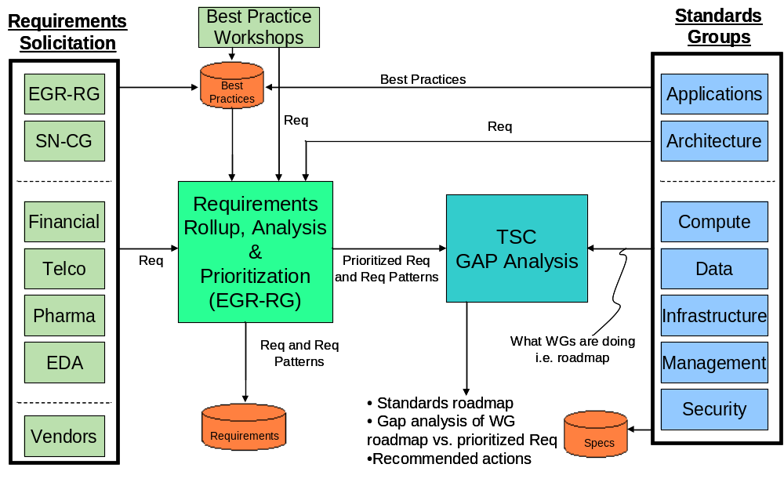
Overall Context Diagram
Enterprise
Requirements
Vendor
Adoption
Enterprises
Use
Grid Technology
Vendors & Dev
Implement
OGF Specifications

Slide 20
Requirements & Standards Alignment
OGF Standards
Alignment
Process
OGF Standards
Enterprise Req
eScience Req
Enterprise Req
eScience Req
TODAY – Alignment?
Improved Alignment

Slide 21
Requirements & Standards Alignment
Promote requirements that OGF is already addressing | WIN-WIN!!
 | Steer OGF standards to be more relevant to the enterprise
Relevance to Enterprise
Relevance to OGF

Slide 22
OGF Enterprise Operational Model
Enterprise
Community
At-Large
BP
Users
“HELP ENTERPRISES USE GRID”
“LISTEN TO ENTERPRISES END USERS”
Solutions
and
Building Blocks
Use Cases,
Requirements
EA
ER
Vendors
&
Developers
Standards
Groups
VDA
Architectures and Specifications
“LISTEN TO VENDORS and HELP THEM ADOPT STANDARDS”

